Slide 1

بسم الله الرحمن الرحيم
HUFFMAN CODING

Slide 2
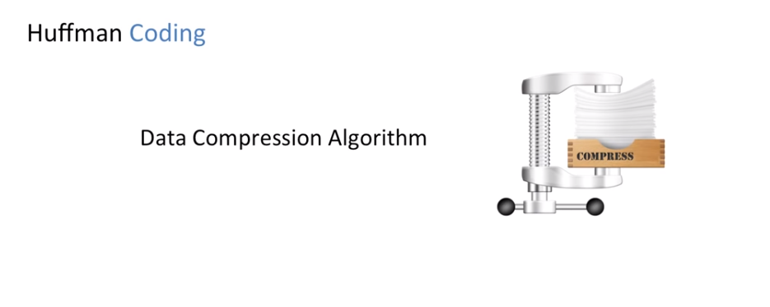
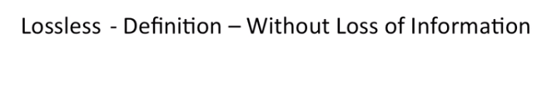


Slide 4
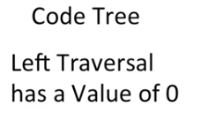
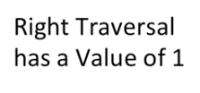
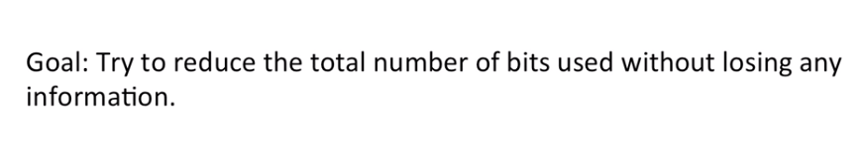
IF I have M choices then I need LOG2(M) bits
HELLO
L-E-H-O
CHAR | FREQUENCY | CODE | BITS
L | 2 | 00 | 4
H | 1 | 01 | 2
E | 1 | 10 | 2
O | 1 | 11 | 2
0
1
0
1
0
1
L
H
E
O
10 bits

Slide 5
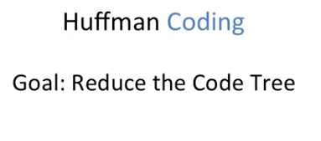
Check if parent > all freqs
CHAR | FREQUENCY
L | 2
H | 1
E | 1
O | 1
5
CHAR | FREQUENCY | CODE | BITS
L | 2 | 0 | 2
H | 1 | 10 | 2
E | 1 | 110 | 3
O | 1 | 111 | 3
0
1
L
3
0
1
2
H
2
0
1
1
E
O
1
1
10 bits

Slide 6
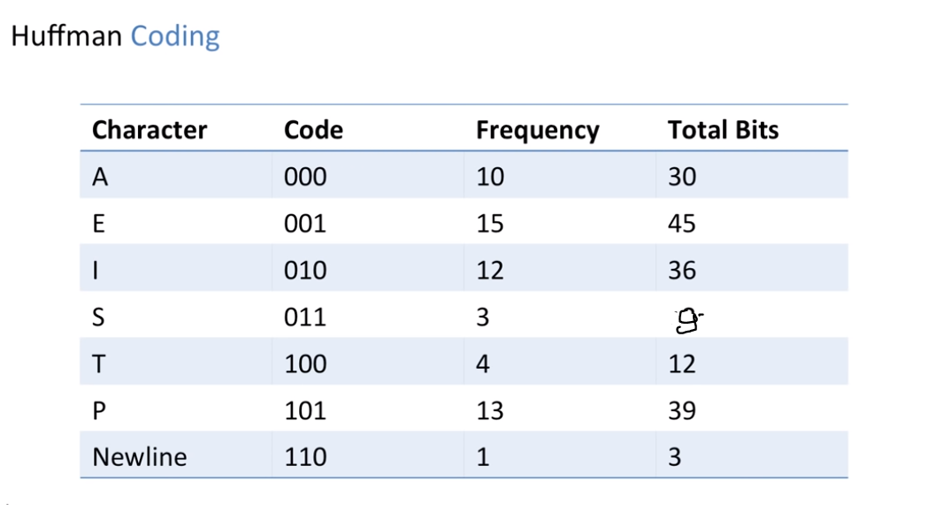


Slide 7
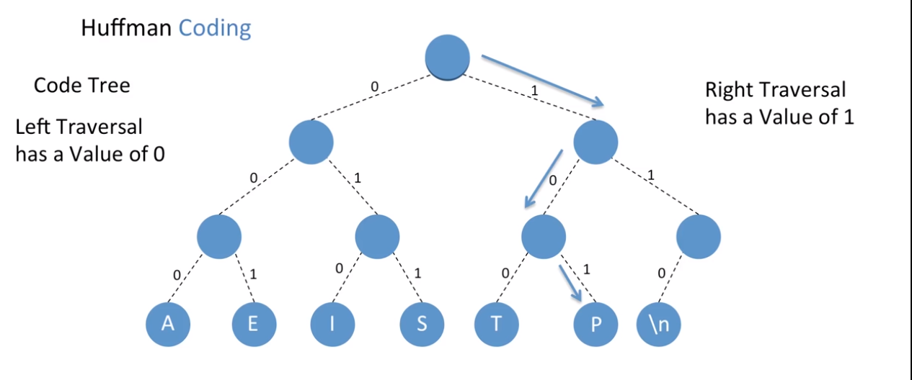

Slide 8
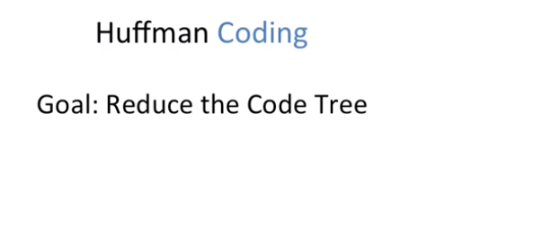
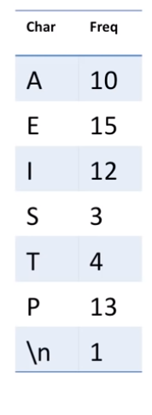

Slide 9
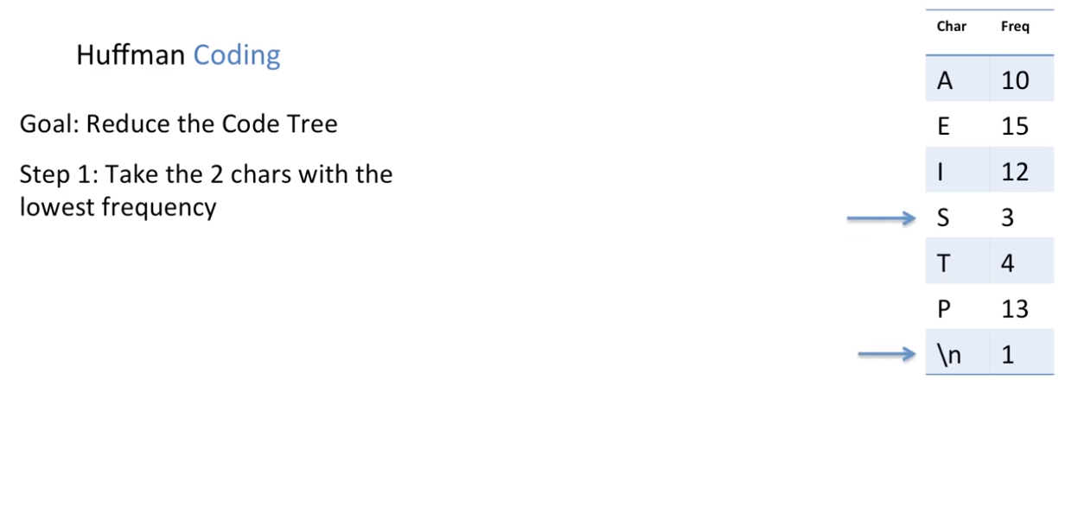

Slide 10
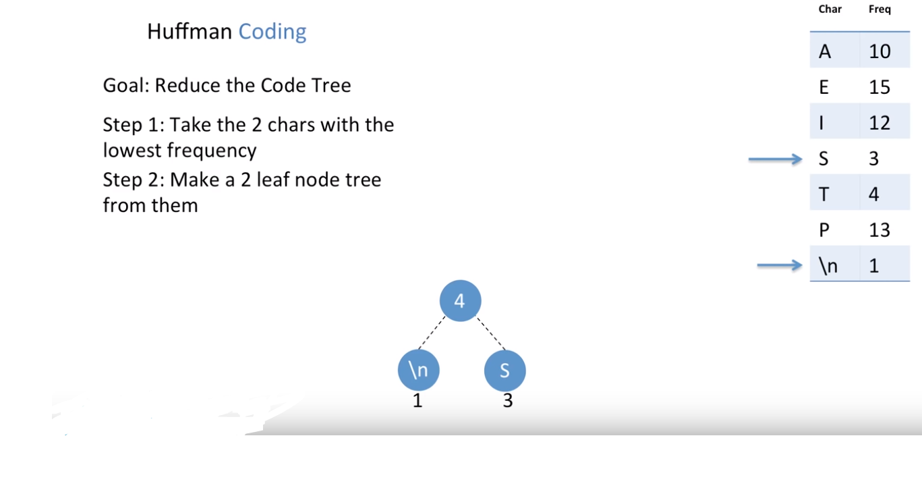

Slide 11
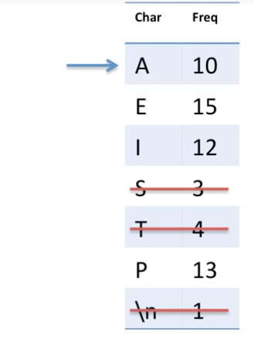
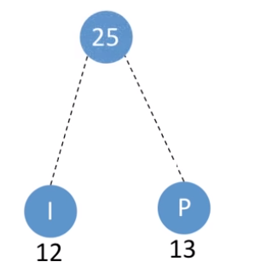
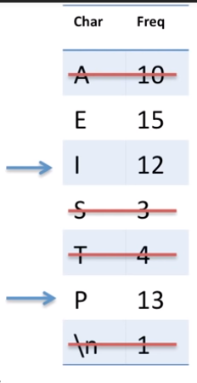
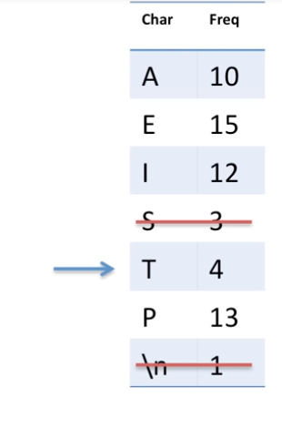
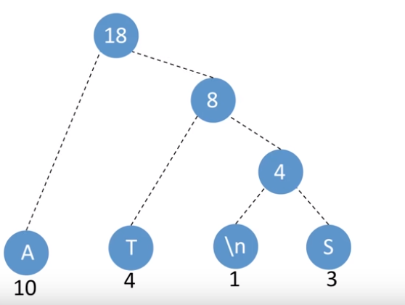
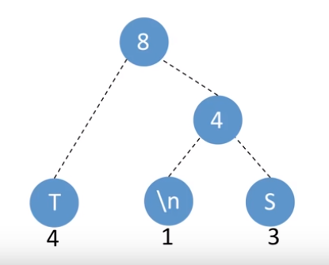

Slide 12
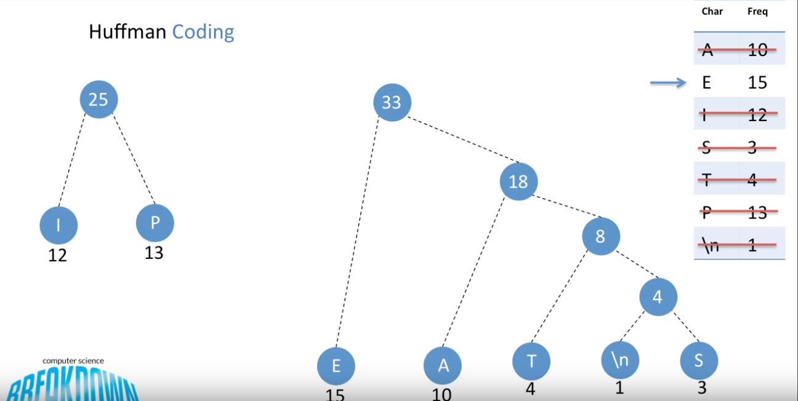

Slide 13
